Slide 1
Waveguide-fed Slot Arrays
Xiuquan Zhang

Slide 2
Introduction
Waveguide-fed slot arrays are a form of Aperture Antenna.
Slots cut in a sidewall of a rectangular waveguide can radiate electromagnetic energy.
It has features of low-loss and high power capability, widely used for communication and radar systems in microwave band and higher.
Arrays can be implemented cutting multiple slots and varying:
Spacing
Shape
Location
Orientation

Slide 3
Waveguide-fed Slot Arrays
Waveguide-fed slot arrays are physically simplified as their feed network and radiating elements are unified.
The design of a desired array factor is complicated by:
Scattering of the waveguide’s internal fields from the slot
Mutual coupling between slots
Arrays can be configured as resonant or travelling wave which differ in:
Direction of main beam
Bandwidth
Impedance

Slide 4
History
Waveguide-fed Slot arrays were first studied during World War II
Increased interest in radar applications
Required high gain antennas
Stevenson[1] provided the first theoretical analysis of the slot antenna derived:
The electric field induced in a slot
The equivalent conductance for a resonant slot
Booker[] derived an equivalence principal of slots and dipoles based on Babinet's principle.
From Stevenson’s and Booker’s work, Elliot[],[] developed a number of design procedures to implement desired array factors for multiple configuration of slots.

Slide 5
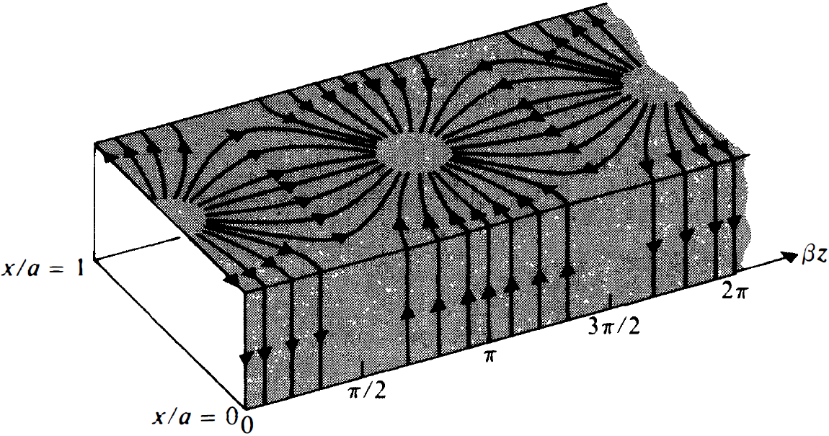
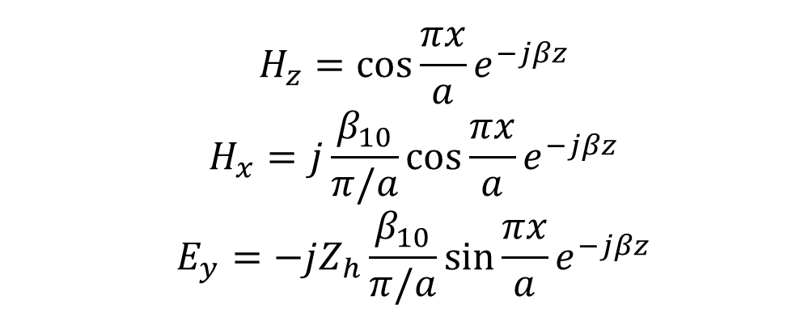
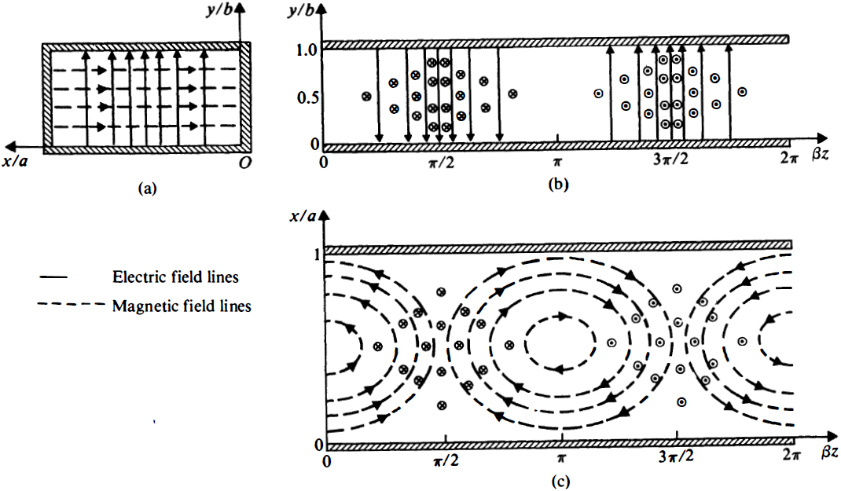
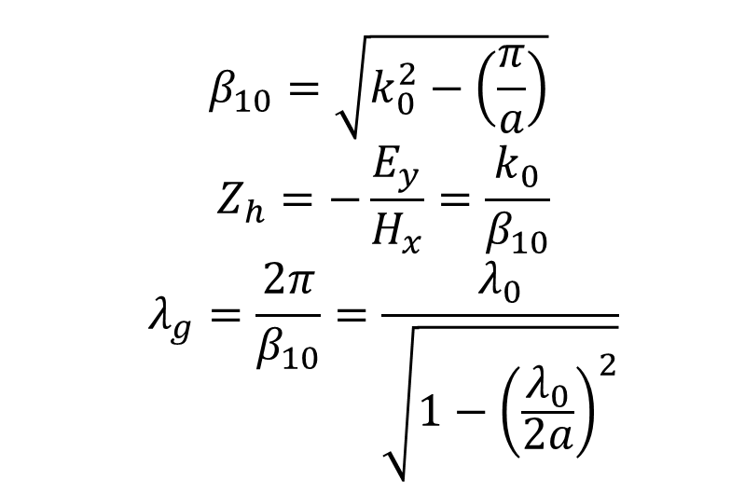
Rectangular Waveguides
A Rectangular Waveguide is a structure that supports travelling waves for discrete modes
Waveguide-fed slot arrays are excited by the TE₁₀ mode, with normalized fields:
Where:

Slide 6
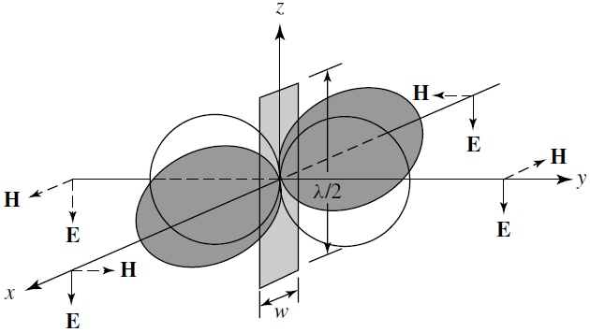
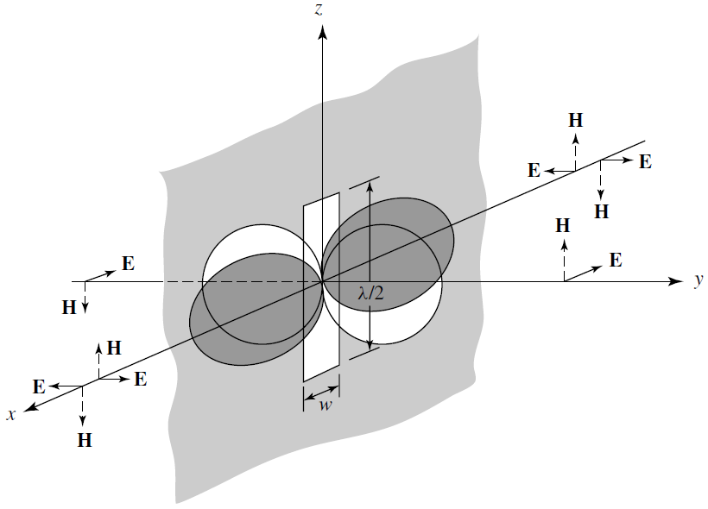
Slot Antenna
An electric-field is induced in a slot that interrupts a waveguide’s surface current.
From the equivalence principle, this field can be treated as surface current radiating away from the waveguide.
Elliott EM
Notes:
Radiationfields of a λ/2 slot ona screen and of a λ/2 flat dipole. (SOURCE: J. D.
Kraus, Antennas, McGraw-Hill, New York, 1988, Chapter 13)

Slide 7
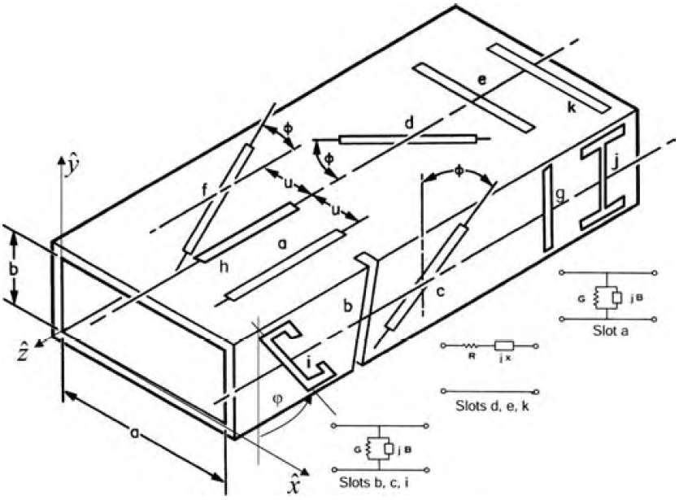
Self-Admittance (Impedance)
Depending on a slot’s position and orientation it can be modeled as either a shunt admittance or series impedance in an equivalent transmission line.
Slots that displace transverse current behave as shunt admittances.
Slots which displace longitudinal current behave as series impedances.
Stevenson first developed expressions for the resonant case and produced curves from measured data. Presently this data is typically obtained using a full wave solver (e.g. HFSS)

Slide 8
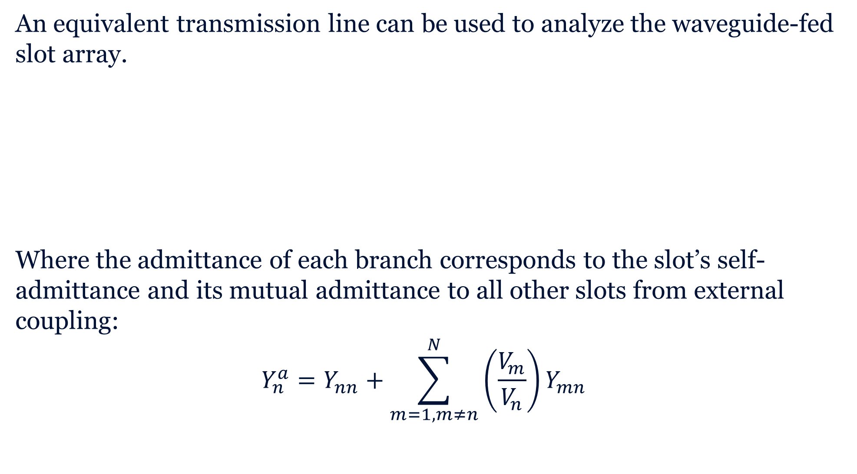
Equivalent Transmission Line
An equivalent transmission line can be used to analyze the waveguide-fed slot array.
Where the admittance of each branch corresponds to the slot’s self-admittance and its mutual admittance to all other slots from external coupling:
$$Y_{n}^{a}=Y_{nn}+\sum_{m=1,m≠n}^{N}{\left(\frac{V_{m}}{V_{n}}\right)Y_{mn}}$$
[1]

Slide 9
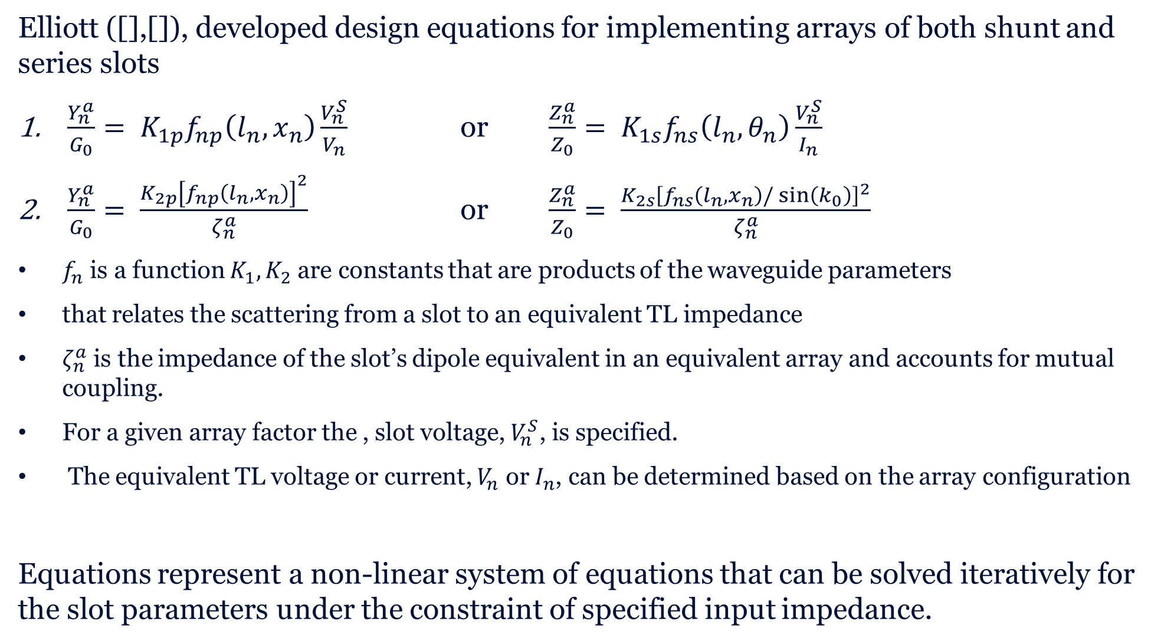
Design Equations
Elliott ([],[]), developed design equations for implementing arrays of both shunt and series slots
$\frac{Y_{n}^{a}}{G_{0}}= K_{1p}f_{np}\left(l_{n},x_{n}\right)\frac{V_{n}^{S}}{V_{n}}$ or $\frac{Z_{n}^{a}}{Z_{0}}= K_{1s}f_{ns}\left(l_{n},θ_{n}\right)\frac{V_{n}^{S}}{I_{n}}$
$\frac{Y_{n}^{a}}{G_{0}}= \frac{K_{2p}{\left[f_{np}\left(l_{n},x_{n}\right)\right]}^{2}}{ζ_{n}^{a}}$ or $\frac{Z_{n}^{a}}{Z_{0}}= \frac{K_{2s}{\left[f_{ns}\left(l_{n},x_{n}\right)/\sin\left(k_{0}\right)\right]}^{2}}{ζ_{n}^{a}}$
$f_{n}$ is a function $K_{1},K_{2}$ are constants that are products of the waveguide parameters
that relates the scattering from a slot to an equivalent TL impedance
$ζ_{n}^{a}$ is the impedance of the slot’s dipole equivalent in an equivalent array and accounts for mutual coupling.
For a given array factor the , slot voltage, $V_{n}^{S}$, is specified.
The equivalent TL voltage or current, $V_{n}$ or $I_{n}$, can be determined based on the array configuration
Equations represent a non-linear system of equations that can be solved iteratively for the slot parameters under the constraint of specified input impedance.

Slide 10
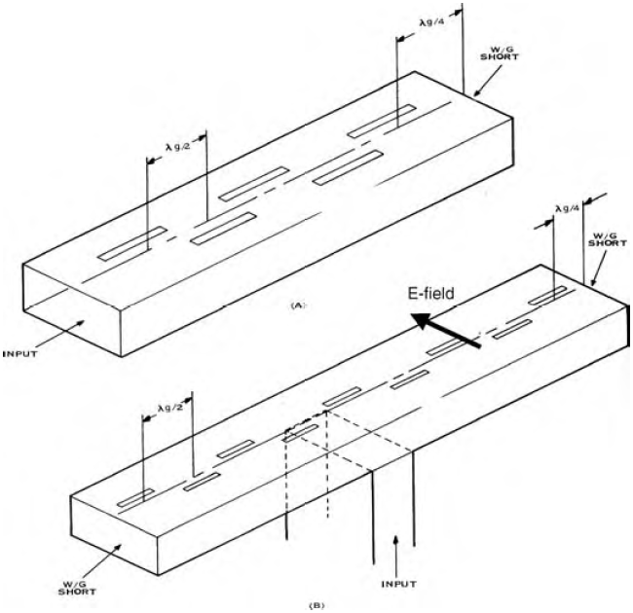
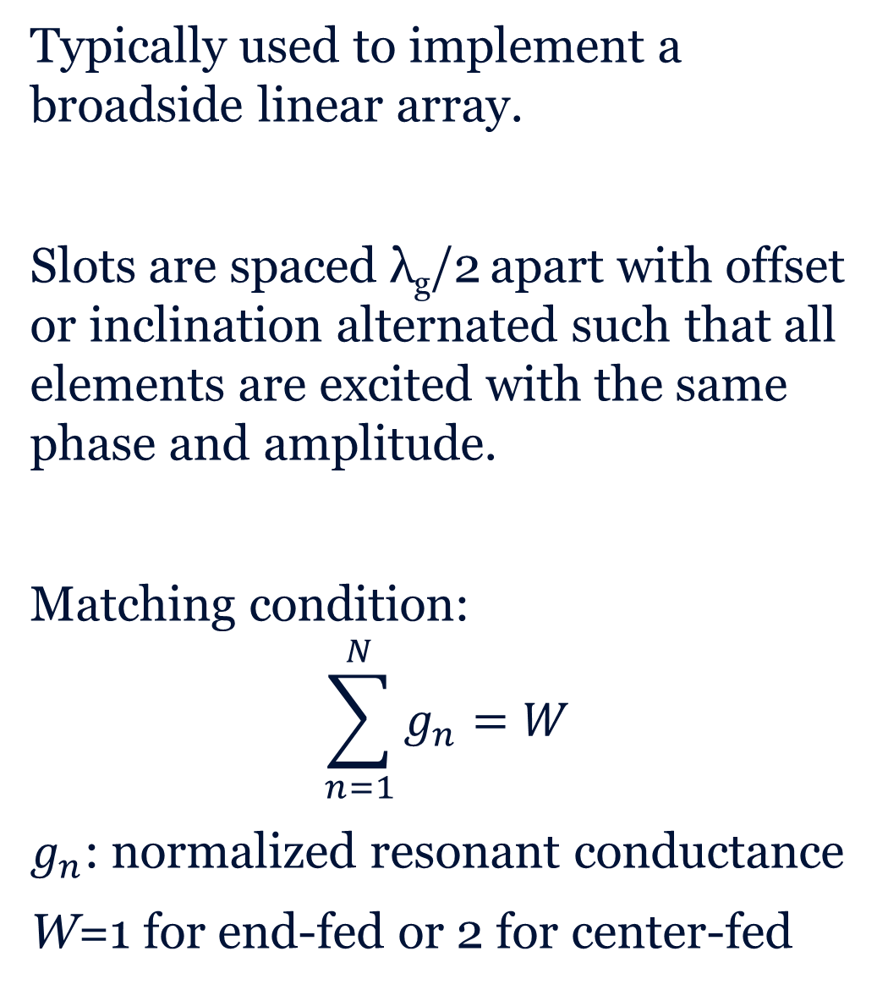
Resonant Array
Typically used to implement a broadside linear array.
Slots are spaced λ_{g}/2 apart with offset or inclination alternated such that all elements are excited with the same phase and amplitude.
Matching condition:
$$\sum_{n=1}^{N}{g_{n}}=W$$
$g_{n}$: normalized resonant conductance
W=1 for end-fed or 2 for center-fed
In (a) the array is fed from the waveguide end. In (b) the array is fed from the center through an E-plane T coupler. It could also be fed by a series or shunt slot from another waveguide on the backside.

Slide 11
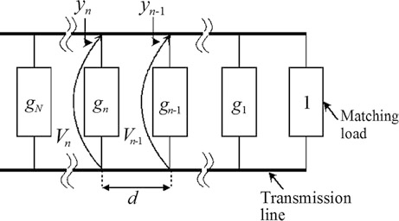
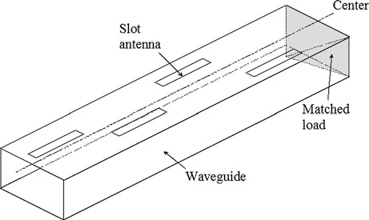
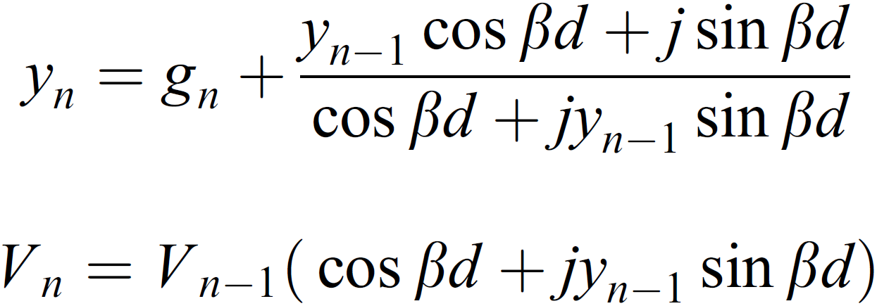
Travelling Wave Array
Slots are spaced by either more or less than λ_{g}/2 apart to avoid standing-wave or resonance condition.
Terminated with matched load to prevent the formation of a secondary beam due to reflected waves.
Fed from the end of the waveguide only.
At the n-th slot, the total admittance looking to the matched load y_{n} and the voltage V_{n} satisfy the following recurrence relations:

Slide 12
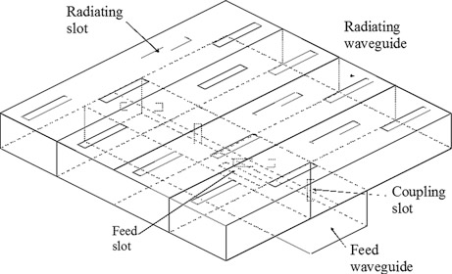
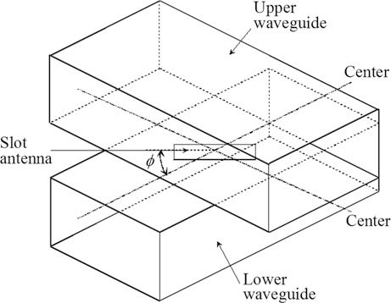
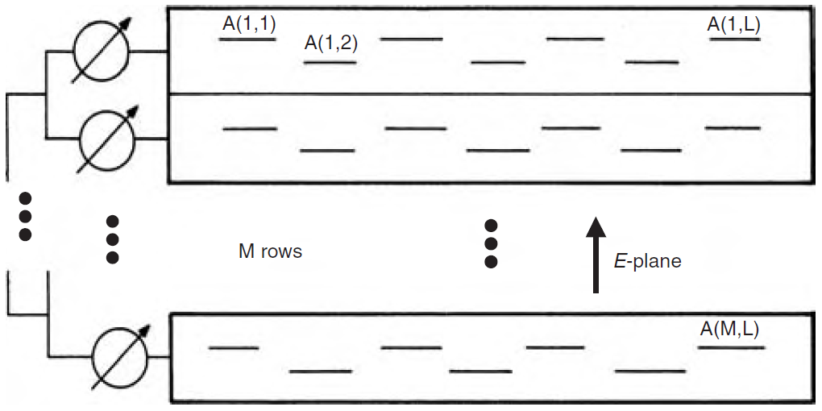
Planar Longitudinal Slot Array
Constructed by placing several linear arrays side by side.
Fed using either series or corporate feeding network.
Series-feed:
Feed waveguide placed under radiating waveguides
Typically fed in phase toward both directions by a longitudinal slot antenna at its center
Inclined coupling slot antennas with opposite orientation among adjacent slots
Corporate-feed:
Radiating waveguides are traveling type with individual phase shifters
When the frequency is changed, the slots on an individual waveguide radiating remain excited in phase, directivity not degraded unlike series-fed.
(a) Series-fed
(b) Corporate-fed

Slide 13
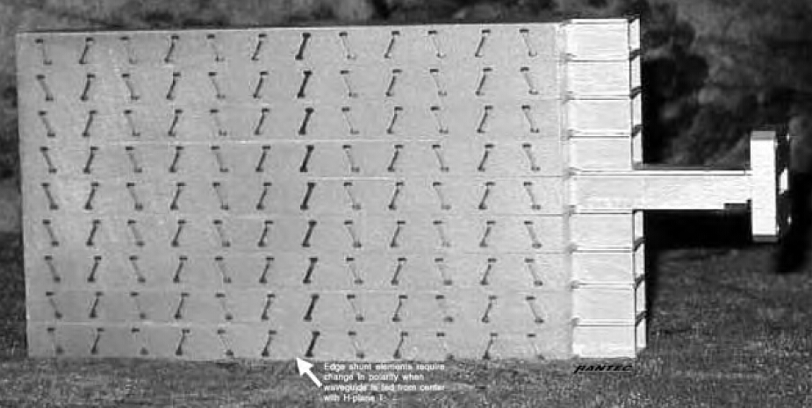
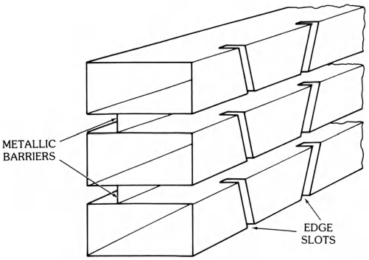
Edge-Wall Shunt-Slot Array
Used when closer inter-element spacing is required for scanning in E-plane with minimal grating lobes
Slot designed to operate at resonance, ≈ λ_{g}/2
Waveguide edge usually less than half its width, the depth of slot cut runs into the broad wall
Spacers needed between adjacent waveguides to prevent slot edges from being covered up.
Difficult in achieving high cross-polarization isolation.

Slide 14
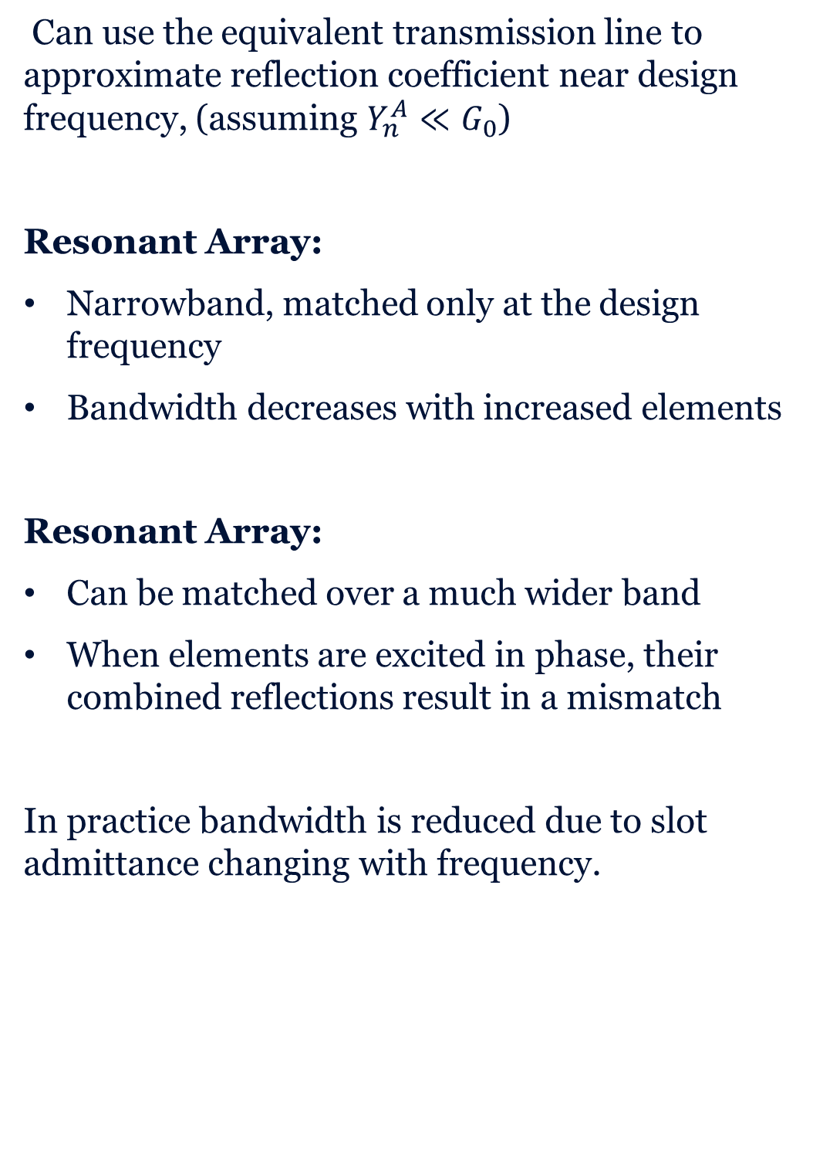
Bandwidth Considerations
Can use the equivalent transmission line to approximate reflection coefficient near design frequency, (assuming $Y_{n}^{A}≪G_{0}$)
Resonant Array:
Narrowband, matched only at the design frequency
Bandwidth decreases with increased elements
Resonant Array:
Can be matched over a much wider band
When elements are excited in phase, their combined reflections result in a mismatch
In practice bandwidth is reduced due to slot admittance changing with frequency.

Slide 15
Advantages and Disadvantages
Both the Resonant and Travelling Wave have a number of advantages:
Can provide high gain radiation patterns
Mechanically simple to construct
Handle high powers
The Resonant Array has the additional benefit of being able to radiate at broadside but has the disadvantage of a narrow bandwidth.
The Travelling Wave Array is able to achieve a larger bandwidth, but sacrifices the ability to steer to broadside. Additionally some power is lost to the load.

Slide 16
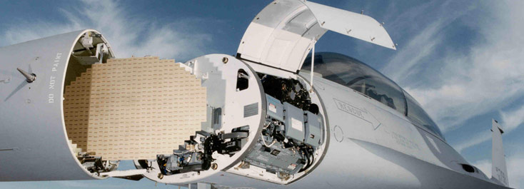
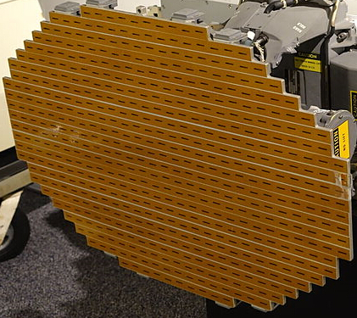

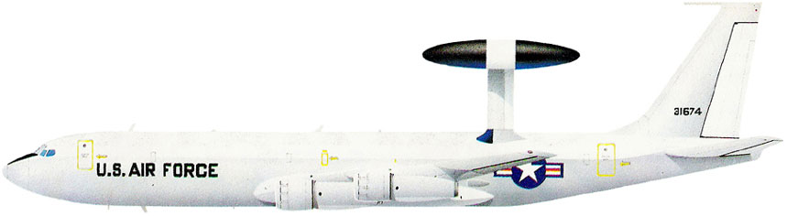
Applications
Widely used in airborne radars and over reflector antennas because the beam pattern can be shaped and monopulse sum and difference ports for tracking can be implemented directly.
Can be positioned above wings and on top of the fuselage while having the capability to look toward the horizon.
Ambient noise gradually decreased from L-band to X-Band, X-band radar systems of 8 to 12.5 GHz are usually used for fighter aircraft.
AN/APG-68 X-band radar for F-16 fighter, Starting Envelope frequency around 9.86 GHz
AWACS Brassboard Antenna
Stacked array of 28 slotted waveguides
Low Sidelobes to minimize ground clutter
Electronic Steering in Elevation for height finding
Notes:
Final Report for Air Force Research Laboratory
Aerospace Systems Directorate
Design Optimization of Slotted Waveguide Antenna Stiffened Structures
https://vtechworks.lib.vt.edu/bitstream/handle/10919/47360/AFRL_FinalReportFY11-13.pdf?sequence=1
http://skillmansofamerica.com/the%20AWACS%20story.pdf

Slide 17
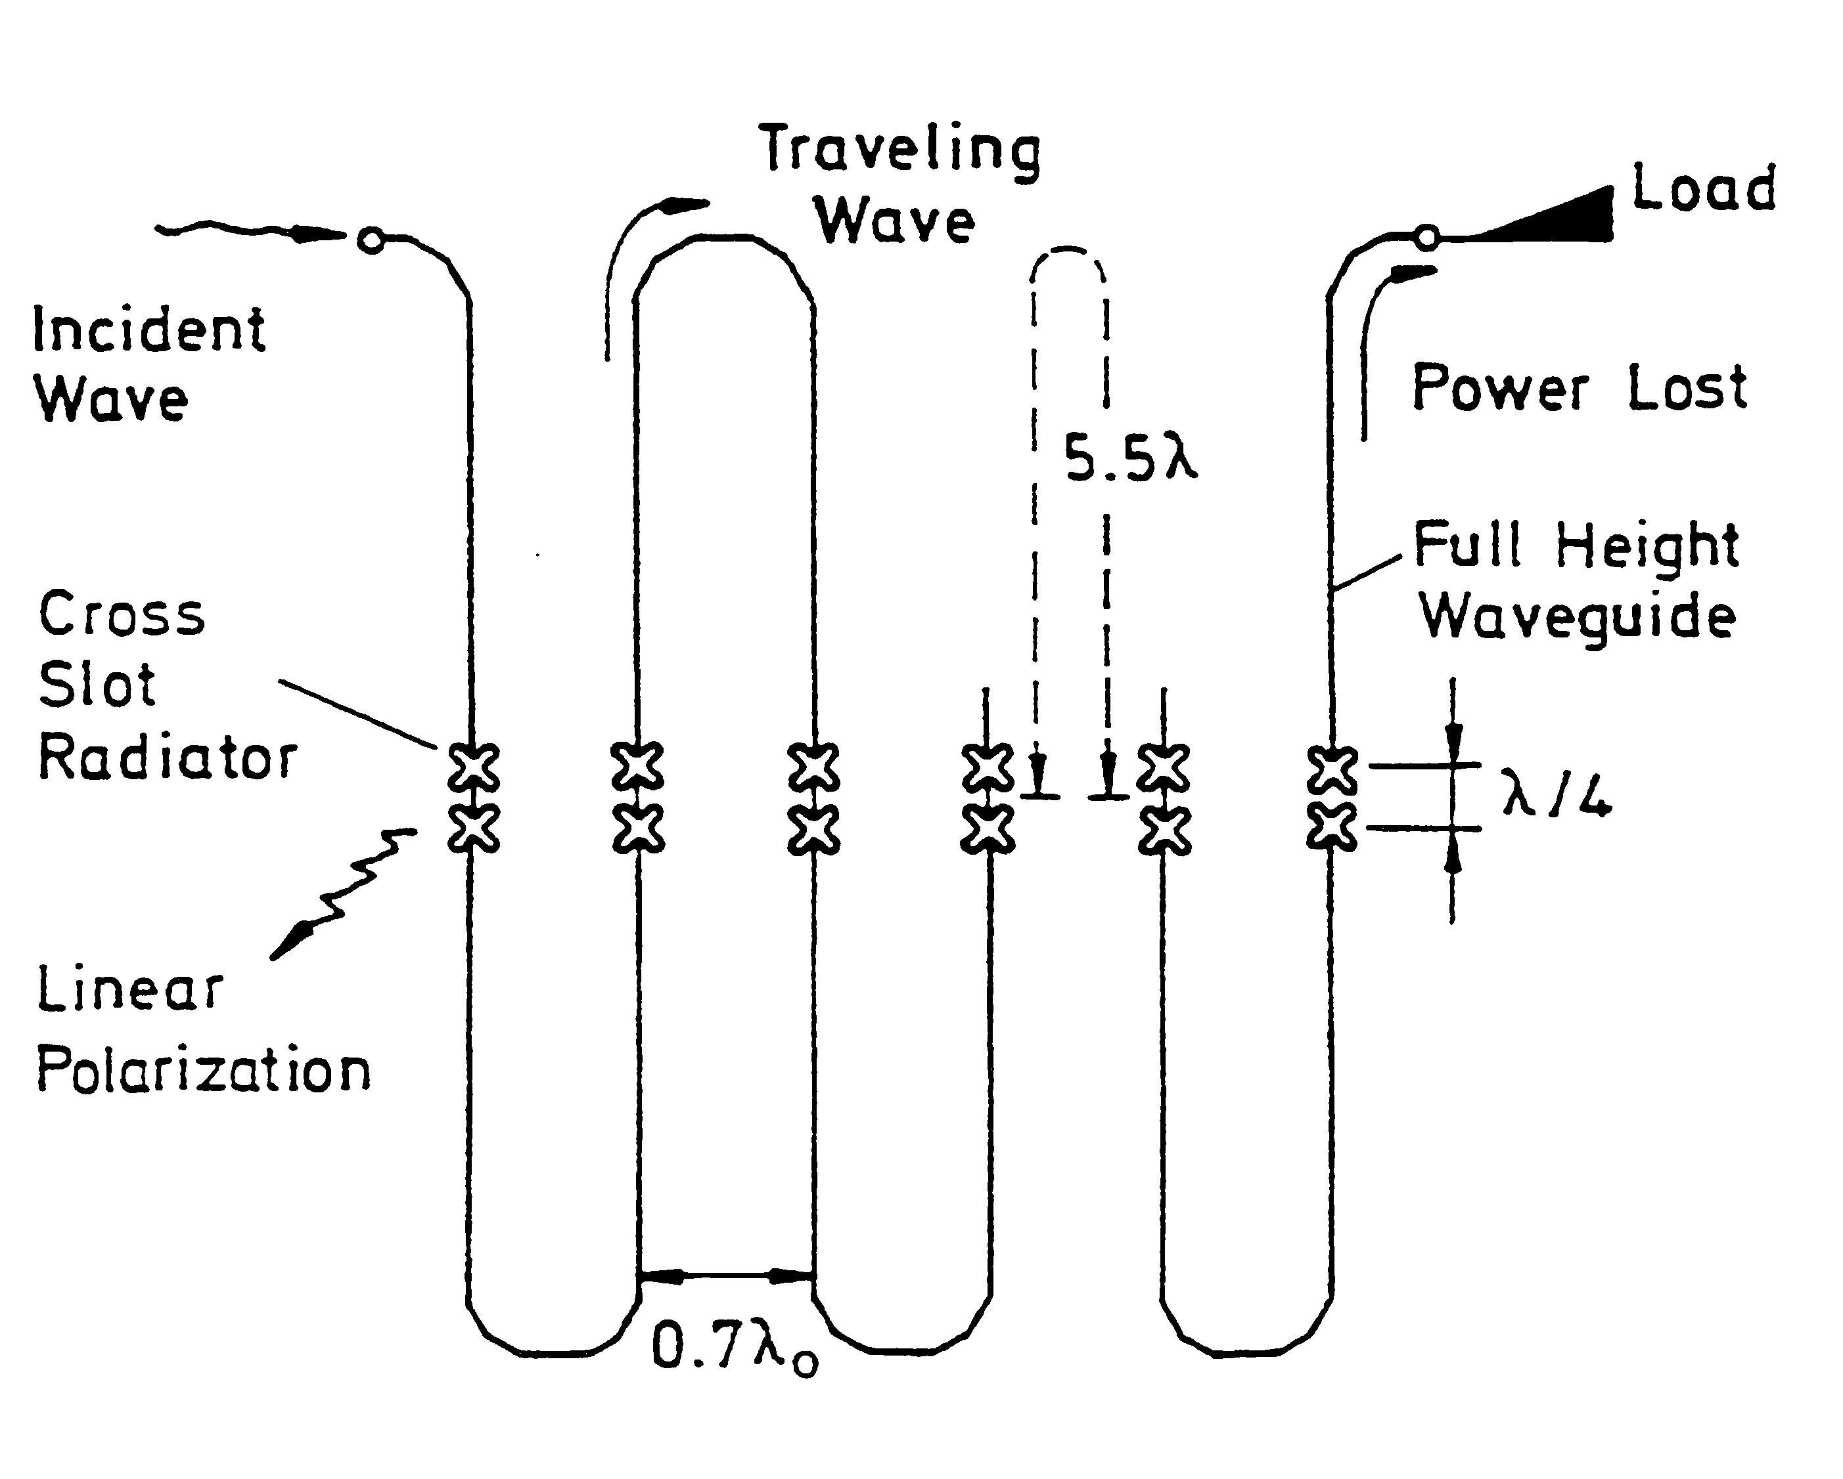
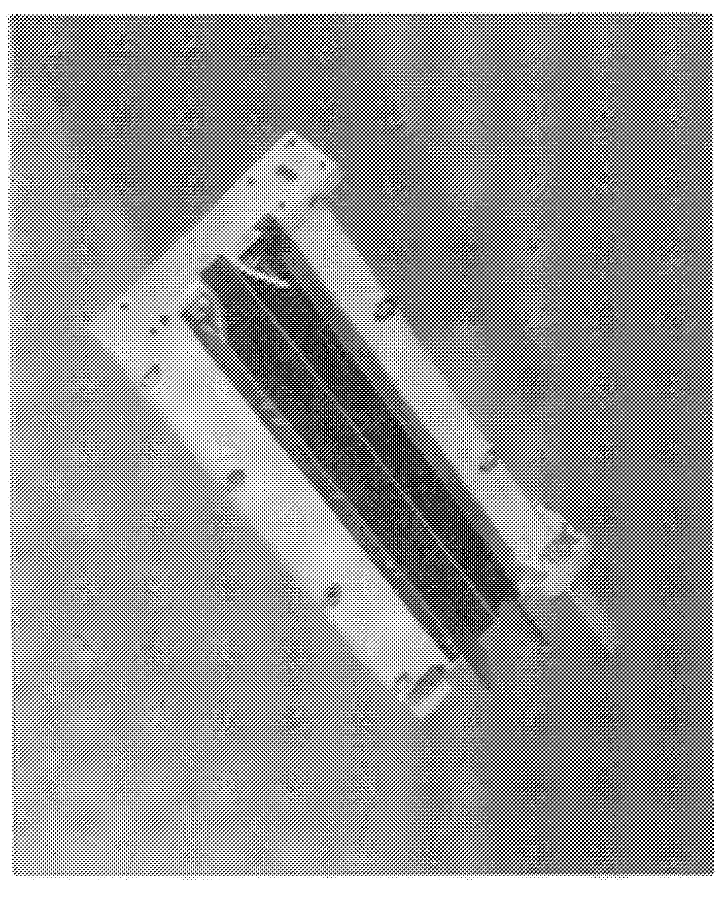
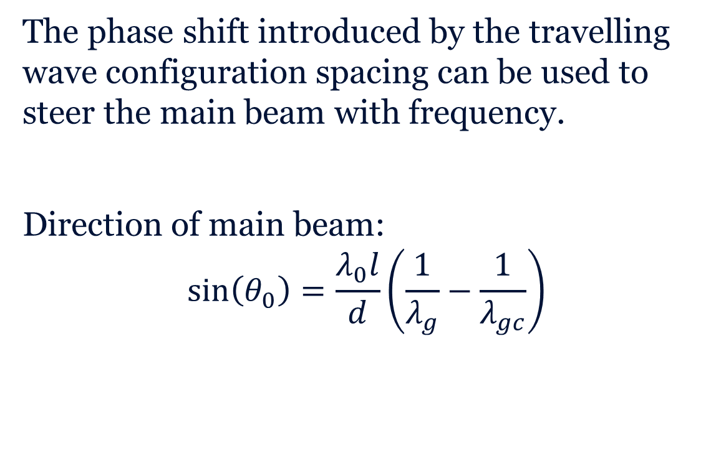
Frequency Scanning Radar[8]
The phase shift introduced by the travelling wave configuration spacing can be used to steer the main beam with frequency.
Direction of main beam:
$$\sin\left(θ_{0}\right)=\frac{λ_{0}l}{d}\left(\frac{1}{λ_{g}}−\frac{1}{λ_{gc}}\right)$$
l
d

Slide 18
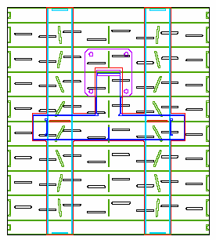
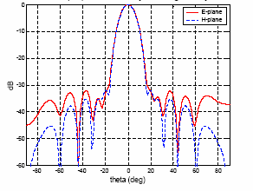
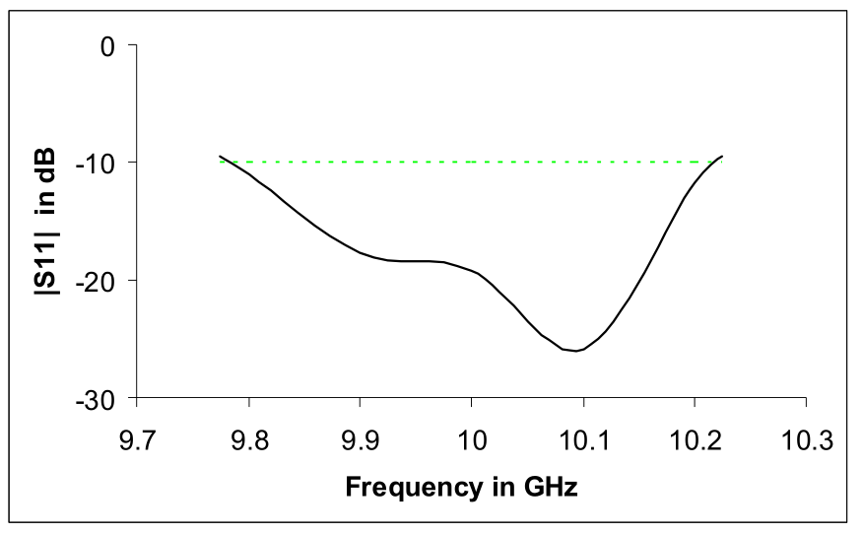
Juno Space Craft Radiometer [5]
Planar Slot array antennas were designed and included on the Juno Spacecraft to detect radiation at the S, C, and X-bands.
The arrays consists of two sub-arrays, each with 32 longitudinal offset slots cut in the broadwalls of 8 stacked rectangular waveguides.

Slide 19
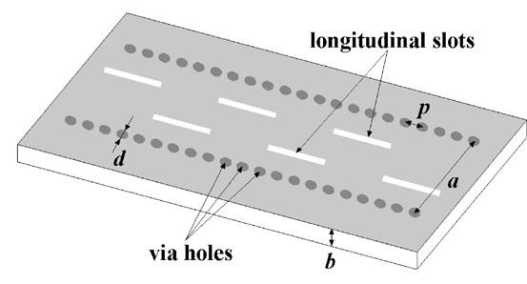
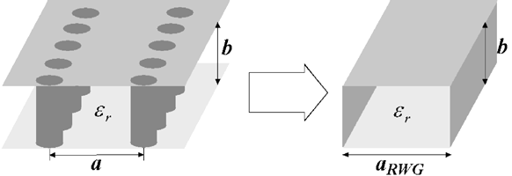
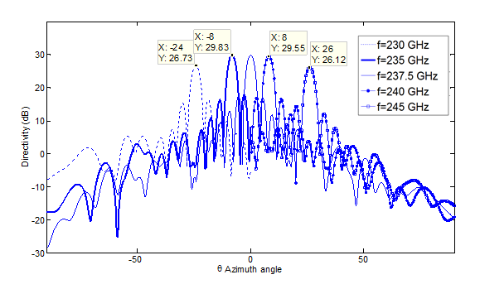
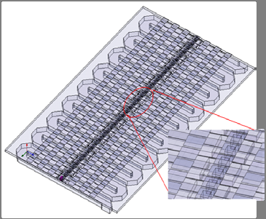
Future Directions
Substrate Integrated Waveguides [6]:
Lower cost
Can achieve higher tolerances
Designs at higher frequencies for large bandwidth requirements:
High-Resolution radar with frequency scanning [7]

Slide 20
Summary
This presentation has briefly talked about the history on studies on waveguide slot antennas, the components for the waveguide slot antennas and various slot configurations are described, and the equivalent circuits for some configurations are given.
Finally, the examples of applications of waveguide slot antennas and future development are introduced.

Slide 21
References
[1]R. Elliott, Antenna theory and design. Hoboken, N.J.: John Wiley & Sons, 2003.
[2]R. Elliott, 'An improved design procedure for small arrays of shunt slots', IEEE Transactions on Antennas and Propagation, vol. 31, no. 1, pp. 48-53, 1983.
[3]A. Oliner, 'The impedance properties of narrow radiating slots in the broad face of rectangular waveguide: Part I--Theory', IRE Trans. Antennas Propag., vol. 5, no. 1, pp. 4-11, 1957.
[4]A. Stevenson, 'Theory of Slots in Rectangular Wave-Guides', J. Appl. Phys., vol. 19, no. 1, p. 24, 1948.
[5]S. Rengarajan, M. Zawadzki and R. Hodges, 'Slot array antennas for the Juno radiometer application', 2008 IEEE Antennas and Propagation Society International Symposium, 2008.
[6] Li Yan, Wei Hong, Guang Hua, Jixin Chen, Ke Wu and Tie Jun Cui, 'Simulation and experiment on SIW slot array antennas', IEEE Microwave and Wireless Components Letters, vol. 14, no. 9, pp. 446-448, 2004.
[7]M. Vahidpour, M. Moallem, J. East and K. Sarabandi, 'Micromachined low-mass RF front-end for beam steering radar', Micro- and Nanotechnology Sensors, Systems, and Applications IV, 2012.
[8]F. Tospann, M. Pirkl and W. Gruener, 'Multifunction 35-GHz FMCW radar with frequency scanning antenna for synthetic vision applications', Synthetic Vision for Vehicle Guidance and Control, 1995.
To add:
RESONANT SLOTS* By W. H. WATSON, M.A., Ph.D.f

